Slide 1

Capstone Project - Clustering Neighborhoods in Downtown Toronto
By Sayed Adel

Slide 2
Introduction
Toronto is the capital city of the Canadian province of Ontario. Toronto is an international center of business, finance, arts, and culture, and is recognized as one of the most multicultural and cosmopolitan cities in the world. On the other hand, Downtown Toronto is the main central business district of Toronto, Ontario, Canada. Located entirely within the district of Old Toronto, it is approximately 17 square kilometers in area.
In the coming slides I’m going to show my analysis and clustration done for Downtown Toronto Borough within Toronto where I explored its neighborhoods to provide some insight for those who are interested in opening a restaurant business in Downtown Toronto by choosing the best neighborhoods and best type of restaurants, in order to increase the probability that the business will succeed

Slide 3
Data
For my analysis I used the below data sources
Information about Toronto from https://en.wikipedia.org/wiki/Toronto
Information about Downtown Toronto from https://en.wikipedia.org/wiki/Downtown_Toronto
List of Borough and Neighborhoods by postal code from https://en.wikipedia.org/wiki/List_of_postal_codes_of_Canada:_M
Geographical Coordinates of each postal code from http://cocl.us/Geospatial_data
Foursquare API to get the most common venues for the neighborhoods in Downtown Toronto

Slide 4
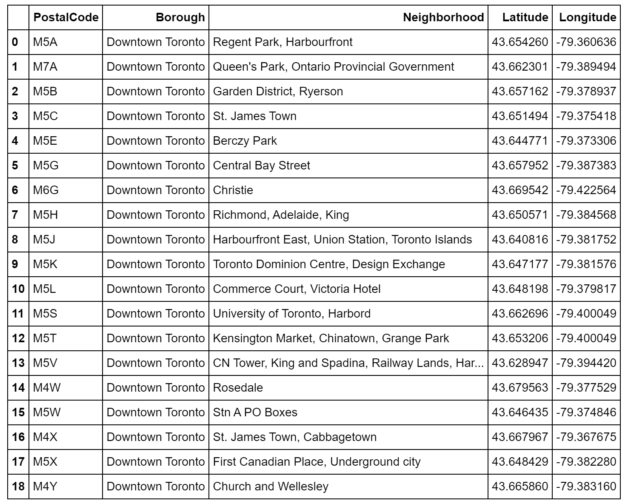
Methodology
The result of processing the data of Toronto Boroughs and Neighborhoods and merging them with the geo coordinates

Slide 5
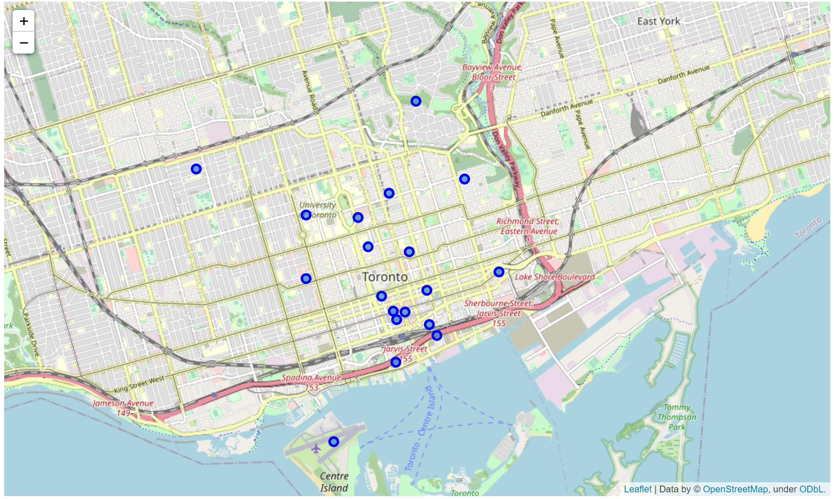
Methodology Cont.
Using Folium to generate a map of the 19 Neighborhoods’ groups in Downtown Toronto

Slide 6
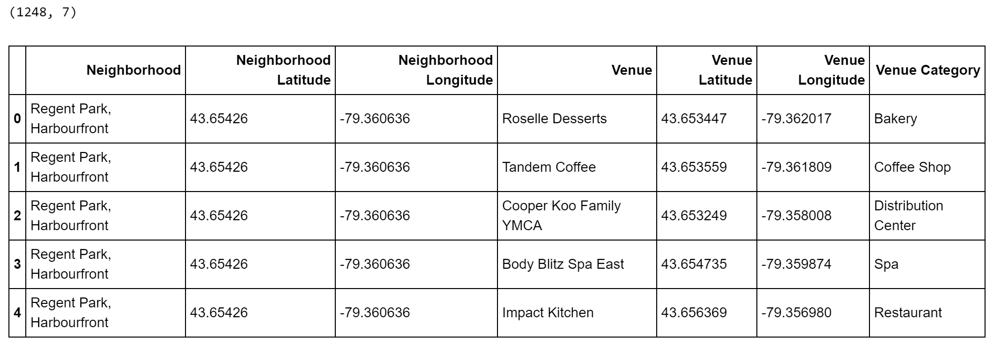
Methodology Cont.
Top 100 venues in Downtown Toronto’s Neighborhoods within a radius of 1000 meters (1248 venues resulted)

Slide 7
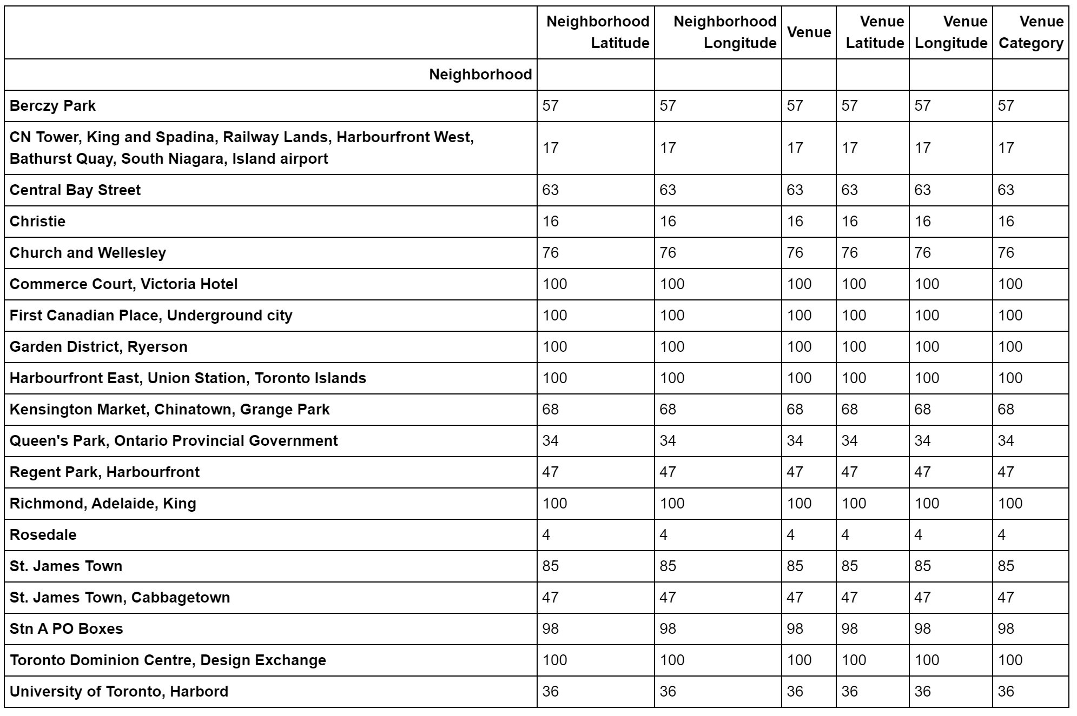
Methodology Cont.
Venues returned for each neighborhood.
It’s founded that there are 207 unique categories can be curated from all the returned venues

Slide 8
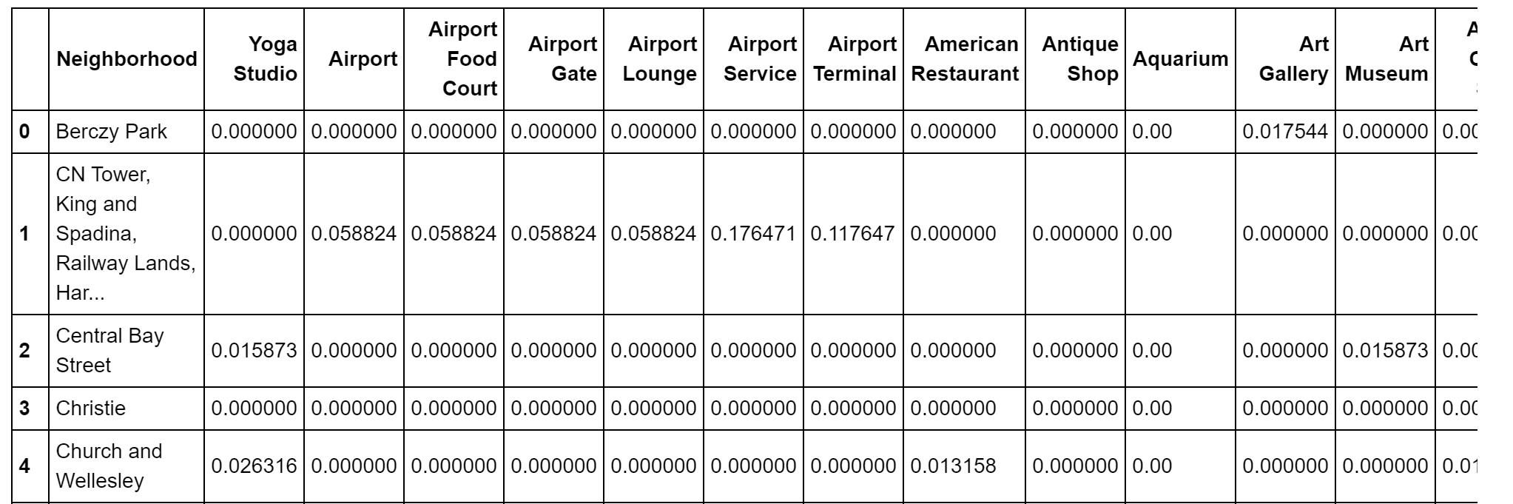
Methodology Cont.
For analyzing the Neighborhoods, the rows grouped by neighborhood and by taking the mean of the frequency of occurrence of each category

Slide 9
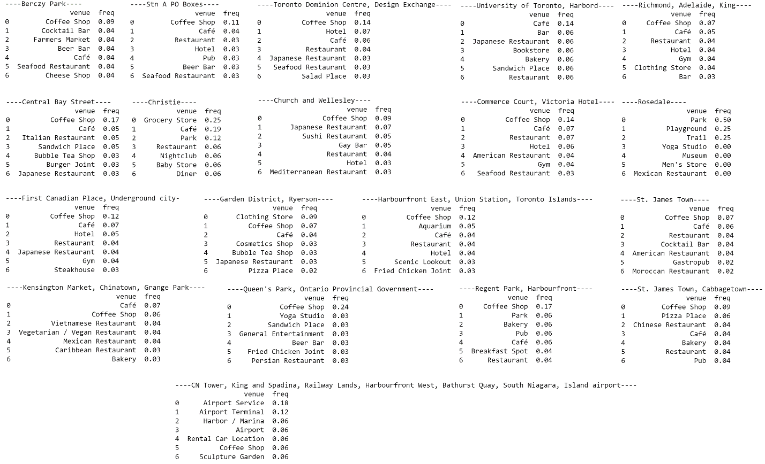
Methodology Cont.
The 7 most common venues for each Neighborhood’s group

Slide 10
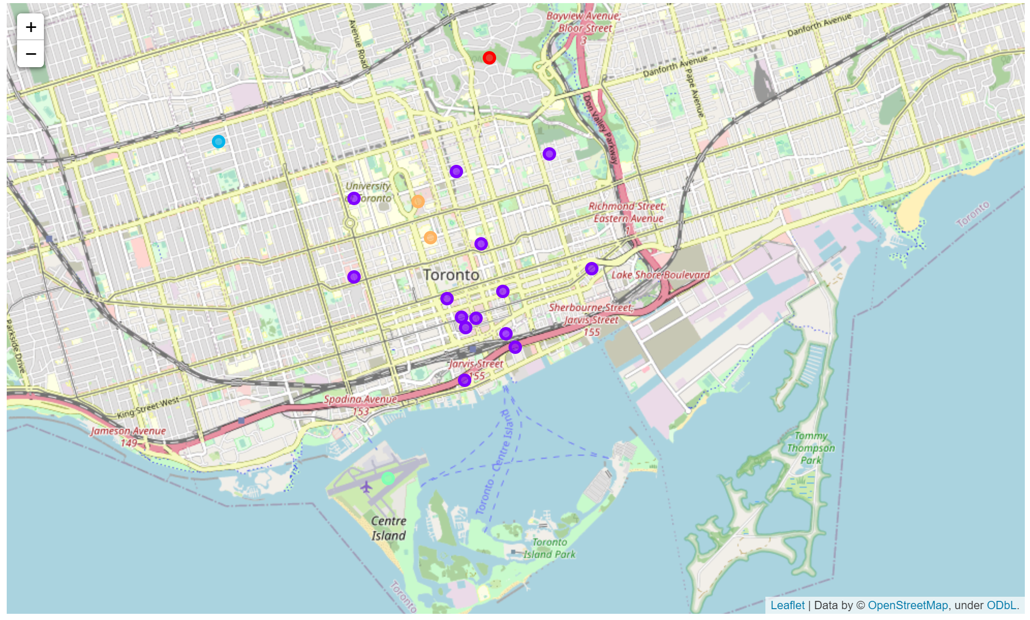
Methodology Cont.
Clustering the Neighborhoods into 5 Clusters. The map shows each cluster

Slide 11
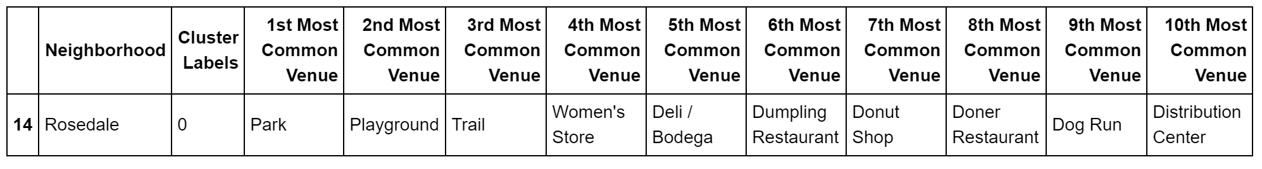
Examining the 5 Clusters
Cluster 1: Entertainment Venues

Slide 12
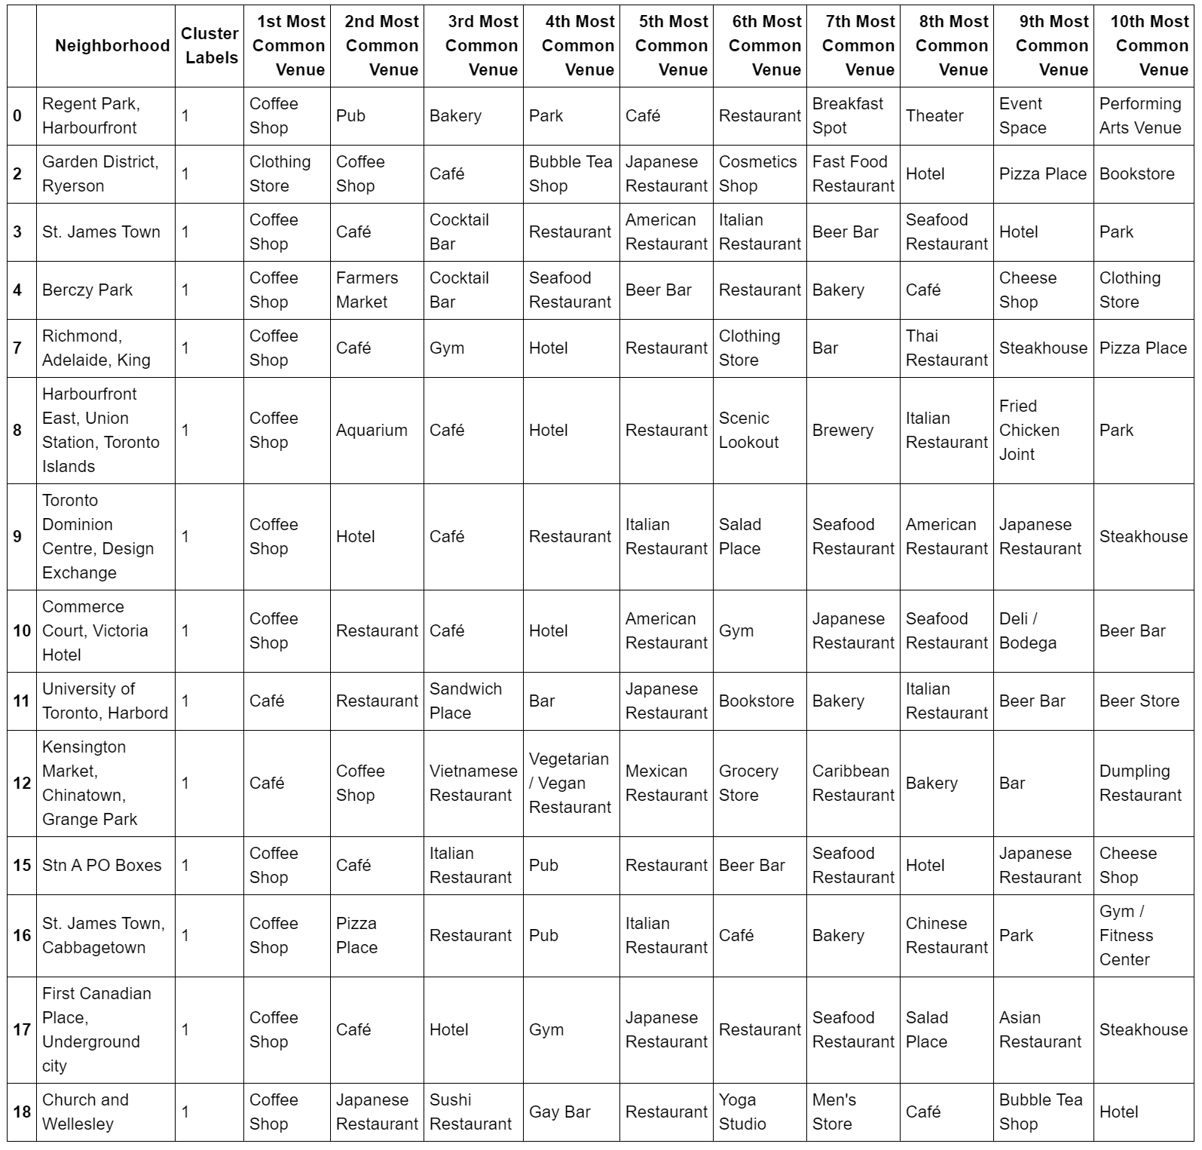
Examining the 5 Clusters
Cluster 2: Intensive Cafe Venues

Slide 13
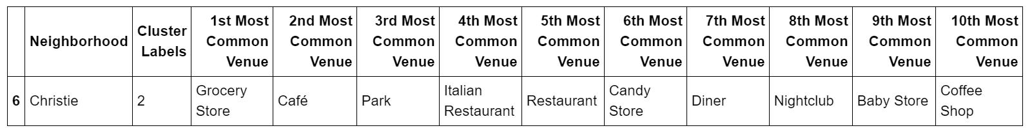
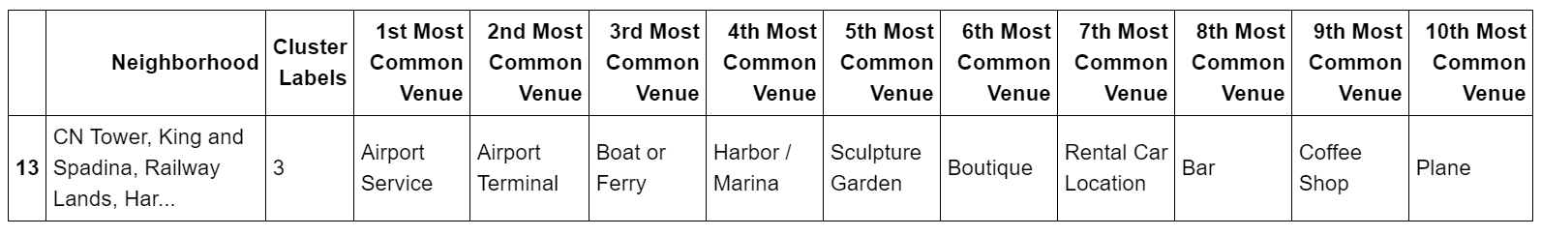
Examining the 5 Clusters
Cluster 3: Versatile Venues
Cluster 4: Transportation Venues

Slide 14
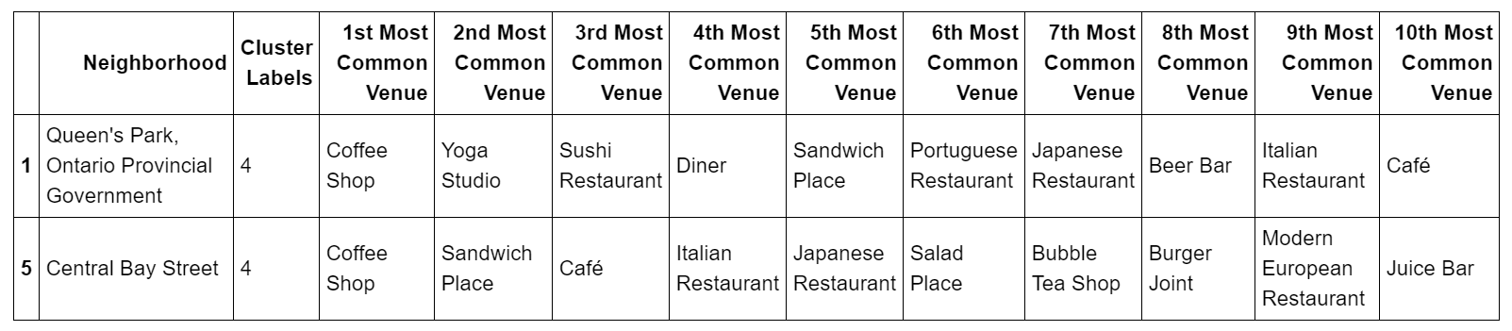
Examining the 5 Clusters
Cluster 5: Restaurants Venues

Slide 15
Discussion
When we look at the results, we can see that there are many Italian, Japanese, American restaurants as an example in many Neighborhoods; therefore, starting a French or Lebanese restaurant would be a good choice or any restaurant in Cluster 1 and 4
The above is just an example; many insights can be extracted from the results

Slide 16
Questions?

Slide 17
Thank you

